Slide 1
SPANNING TREE
Dr. Yasir | Programming Domain

Slide 2
Spanning tree
A spanning tree is a subset of Graph G
It includes all the vertices along with the least possible number of edges
If any vertex is missed, it is not a spanning tree.
spanning tree does not have cycles and it cannot be disconnected..
Notes:
Insert a map of your country.

Slide 3
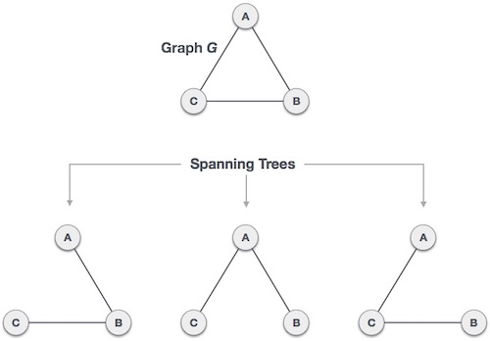
Example:
three spanning trees off one complete graph.
A complete undirected graph can have maximum n^{n-2} number of spanning trees,
where n is the number of nodes.
Here n is 3, hence 3³⁻² = 3 spanning trees are possible.
Notes:
Insert a map of your country.

Slide 4
A spanning tree consists of (n-1) edges, where 'n' is the number of vertices (or nodes).
Edges of the spanning tree may or may not have weights assigned to them
All the possible spanning trees created from the given graph G would have the same number of vertices,
Notes:
Insert a map of your country.

Slide 5
the number of edges in the spanning tree would be equal to the number of vertices in the given graph minus 1.
Notes:
Insert a map of your country.

Slide 6
Applications of the spanning tree
spanning tree is used to find a minimum path to connect all nodes of the graph.
Cluster Analysis
Civil network planning
Computer network routing protocol Consider, city network as a huge graph and now plans to deploy telephone lines in such a way that in minimum lines we can connect to all city nodes.
Notes:
Insert a map of your country.

Slide 7
Properties of Spanning Tree
A connected graph G can have more than one spanning tree
All possible spanning trees of graph G, have the same number of edges and vertices.
The spanning tree does not have any cycle (loops).
Removing one edge from the spanning tree will make the graph disconnected, i.e. the spanning tree is minimally connected.
Adding one edge to the spanning tree will create a circuit or loop, i.e. the spanning tree is maximally acyclic.
Notes:
Insert a map of your country.

Slide 8
Mathematical Properties of Spanning Tree
Spanning tree has n-1 edges, where n is the number of nodes (vertices).
From a complete graph, by removing maximum e - n + 1 edges, we can construct a spanning tree.
A complete graph can have maximum n^{n-2} number of spanning trees.
Notes:
Insert a map of your country.

Slide 9
Minimum Spanning tree
A minimum spanning tree can be defined as the spanning tree in which the sum of the weights of the edge is minimum
The weight of the spanning tree is the sum of the weights given to the edges of the spanning tree.
The minimum spanning tree from a graph is found using the Prim's Algorithm and Kruskal's Algorithm
Notes:
Insert a map of your country.

Slide 10
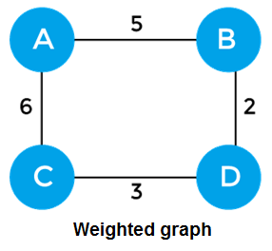
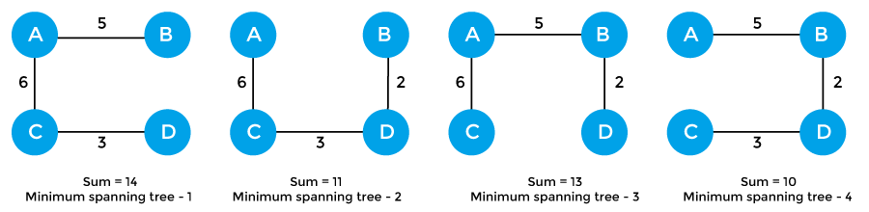
Example of minimum spanning tree
The sum of the edges of the above graph is 16.
Now, some of the possible spanning trees created from the above graph are –
Notes:
Insert a map of your country.

Slide 11
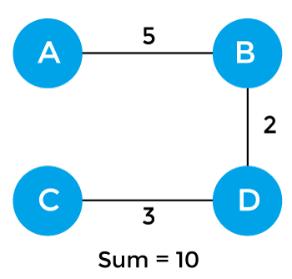
the minimum spanning tree selected:-
Notes:
Insert a map of your country.

Slide 12
Applications of minimum spanning tree
To find paths in the map
To design networks like telecommunication networks, water supply networks, and electrical grids.
Notes:
Insert a map of your country.

